Slide 1
E-Invoicing

Slide 2
Introduction
• What is e-invoice
• Invoice generated by a software on the computer is an e-invoice?
• Whether invoices generated in a central server is an
e-invoice ?
• E-invoice does not mean generation of invoices from a
central portal of tax department

Slide 3
Introduction ( Contd)
Invoice generated by each software may look more or less same.
But they can’t be understood by another computer system even though business users understand them fully.
For example, an Invoice generated by SAP system cannot be read by a machine which is using ‘Tally’ system.
Likewise there are hundreds of accounting/billing software.
Data on such invoices can’t be understood by the GST System if reported in their respective formats

Slide 4
Current Status
• Separate reporting of invoice data for GST Return and e-way Bill
• Both have different formats and hence the taxpayer has to prepare them every time.
• The format of reporting in GSTR-1 and that for e-way bill are different from original invoice
• Lots of errors creep in manual processing by businesses.
• Unscrupulous elements generate fake invoices, push them in the GST system and vanish.

Slide 5
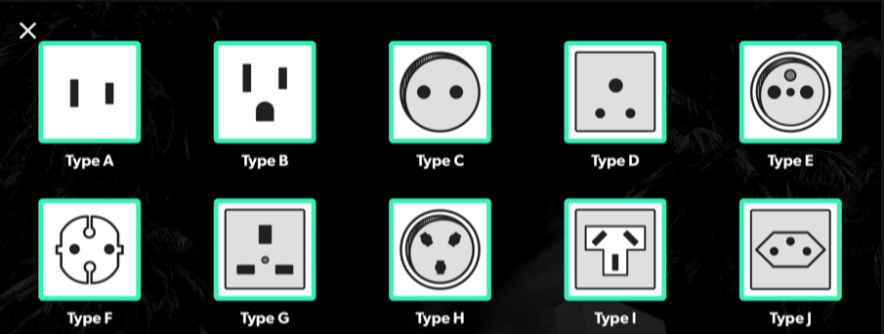
Absence of standard

Slide 6
Standardisation
Hence a need was felt to standardize the format for sharing the data with others.
All these software would adopt the new e-Invoice standard wherein they would re-align their data access and retrieval in the standard format
However, users of the software would not find any change since they would continue to see the physical output of the invoices in the same manner as it existed before

Slide 7
Why E-invoice?
The e-invoice system being implemented by tax departments across the globe consists of two important parts namely,
  a) Generation of invoice in a standard format so that invoice generated on one system can be read by another system.
  b) Reporting of e-invoice to a central system.
  c) Reduction of Manual data entry,
Manual data entry leads to the following:
  Transcription errors
  Wrong entries
  Need for standards to ensure complete inter-operability
  Elimination of need of manual data entry and transcription errors

Slide 8
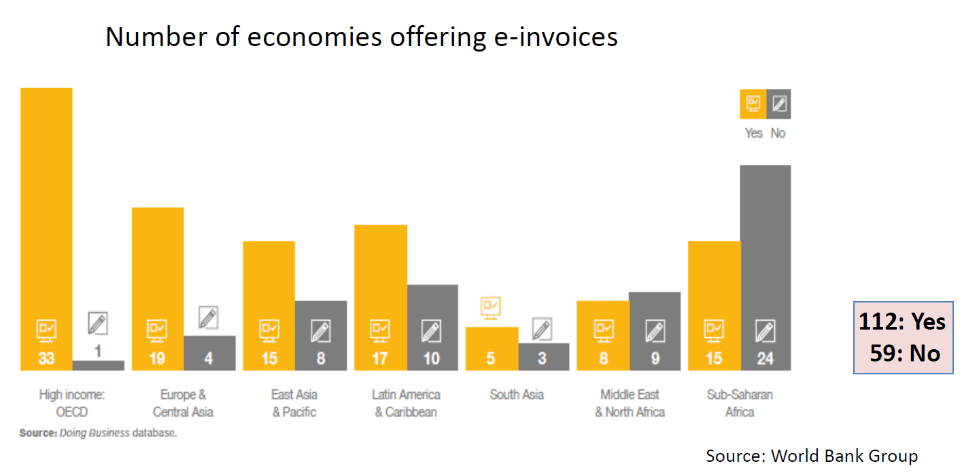
Economies offering e-invoices

Slide 9
Legal Background
Notification | Date | Legal provisions
68/2019-CT | 13.12.2019 | Sub-Rules (4),(5) and (6) inserted to Rule 48 of CGST Rules
69/2019-CT | 13.12.2019 | Notifying 10 e-invoicing portals (i) www.einvoice1.gst.gov.in; (ii) www.einvoice2.gst.gov.in; (iii) www.einvoice10.gst.gov.in
70/2019-CT | 13.12.2019 | E-invoice applicable to tax payers having aggregate Turnover exceeding Rs. 100 Crores in respect of B to B transactions
71/2019-CT | 13.12.2019 | E- invoice with QR Code mandatory w.e.f 01.04.2020
71/2019-CT | 13.12.2019 | QR Code for B to C invoices mandatory w.e.f 01.04.2020 for tax payers having aggregate Turnover Exceeding Rs. 500 Crores

Slide 10
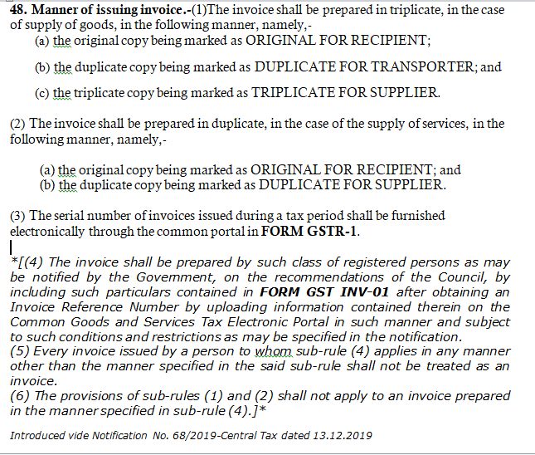

Slide 11
Applicability of e-invoice
B to B : Business to Business
B to G : Business to Government
Export
Through E-Commerce Operators
Reverse Charged transactions

Slide 12
Applicability of E-Invoice
Invoices
Debit Note
Credit Note
The following are not to be entered
  Delivery challan
  Bill of Supply
  Job work

Slide 13
Process of e invoice
E-invoice will be created by Taxpayers on their own accounting/billing/ERP System
The e-invoice, as prepared, will be reported on Invoice Reference Portals (IRP)
IRP will generate unique Invoice Reference Number (IRN) which will be attached on the e-invoice and system will digitally sign the same and return to taxpayer (supplier) as well as recipient.

Slide 14
The IRP will also generate a QR code which will consist of the following :
  GSTIN of supplier & Recipient
  Invoice number as given by Supplier
  Date of generation of invoice
  Invoice value (taxable value and gross tax)
  Number of line items
  HSN Code of main item (the line item having highest taxable value)
  Unique Invoice Reference Number (hash)

Slide 15
QR code will enable Offline verification using Mobile App.
A taxpayer can continue to print his invoice as being done presently with logo.
e-invoicing system only mandates all taxpayers to report invoices on IRP in electronic format.

Slide 16
ANX-1 & ANX-2 of the New Returns will be auto filled with the data available in e-invoice system.
E-Way bill system will create Part-A of e-way bill using e-invoicing data. The person responsible will have to fill part-B for generation of e-way bill at the time of movement of the goods

Slide 17
Modes for getting invoice registered
Multiple modes made available so as to facilitate taxpayer to use any of the following based on his/her need.
Web based
API based
SMS based
Offline tool based
GSP based

Slide 18
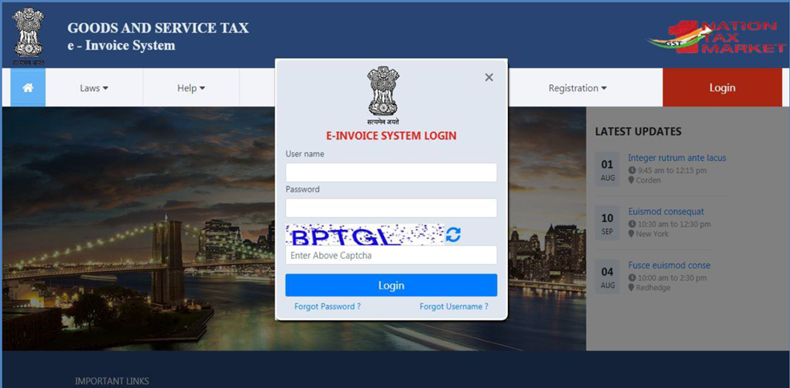
Login Page
If already registered with E-way bill, can use the same user id and password to login, if not can create the user id login by registering.
The e-invoice and GST system are interlinked and both the portal shares the information in common.

Slide 19
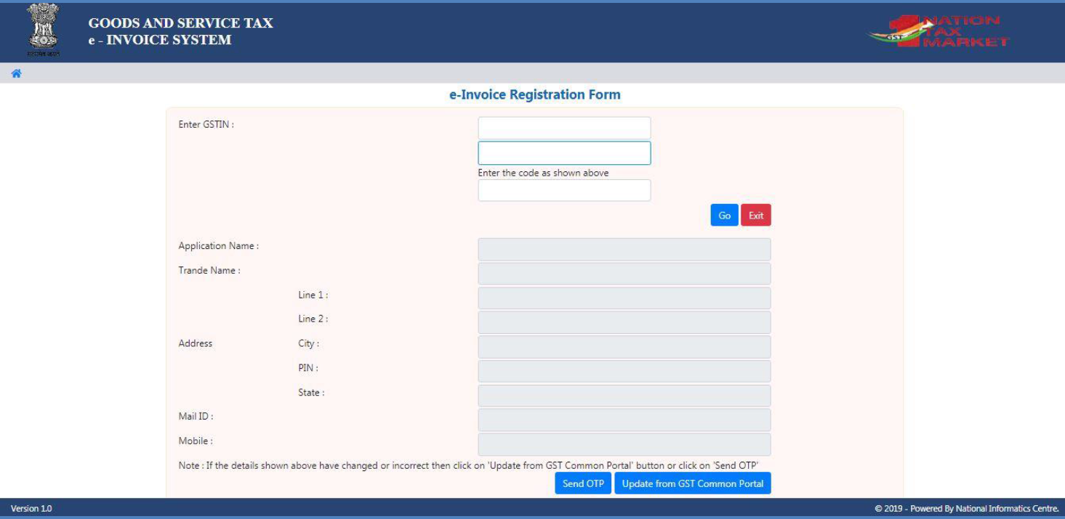
REGISTRATION FORM

Slide 20
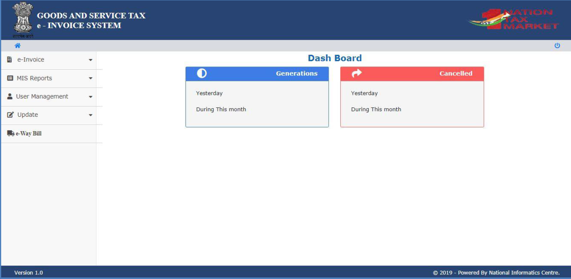
Main Menu of Screen

Slide 21
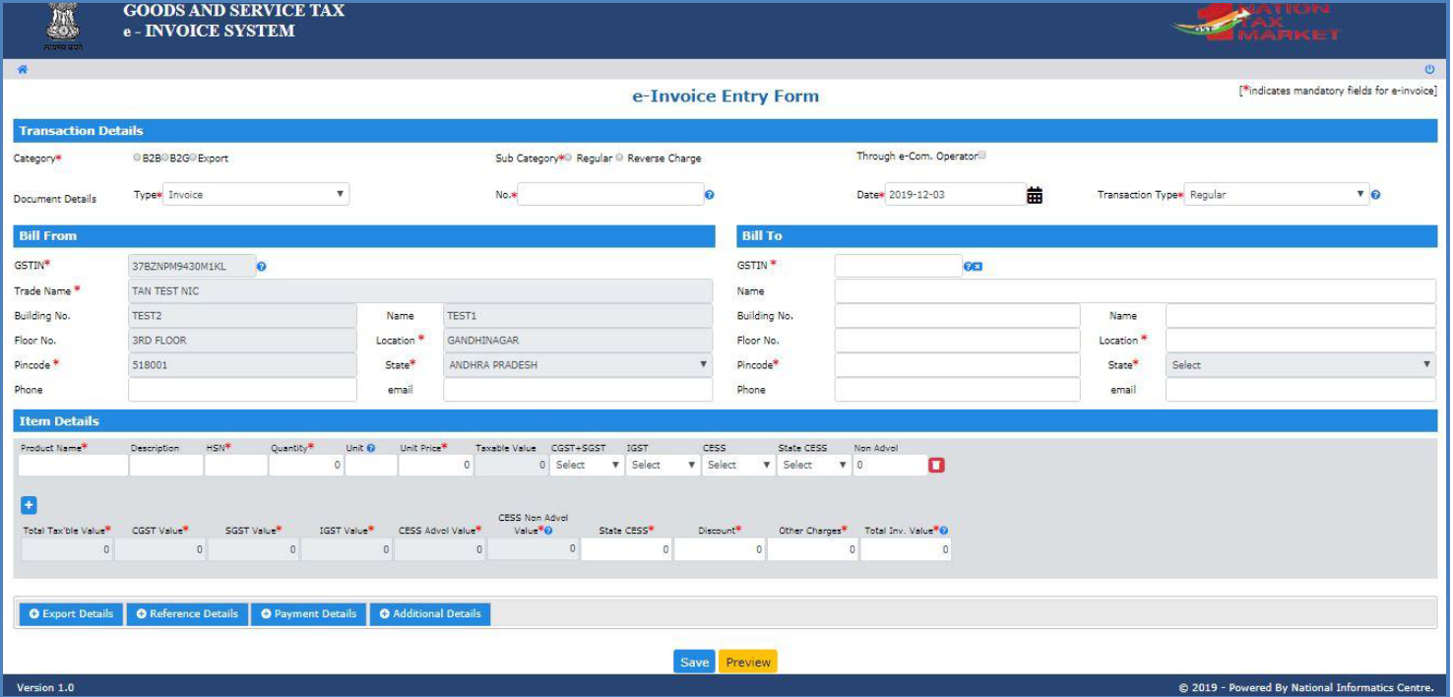
IRN Generation FORM

Slide 22
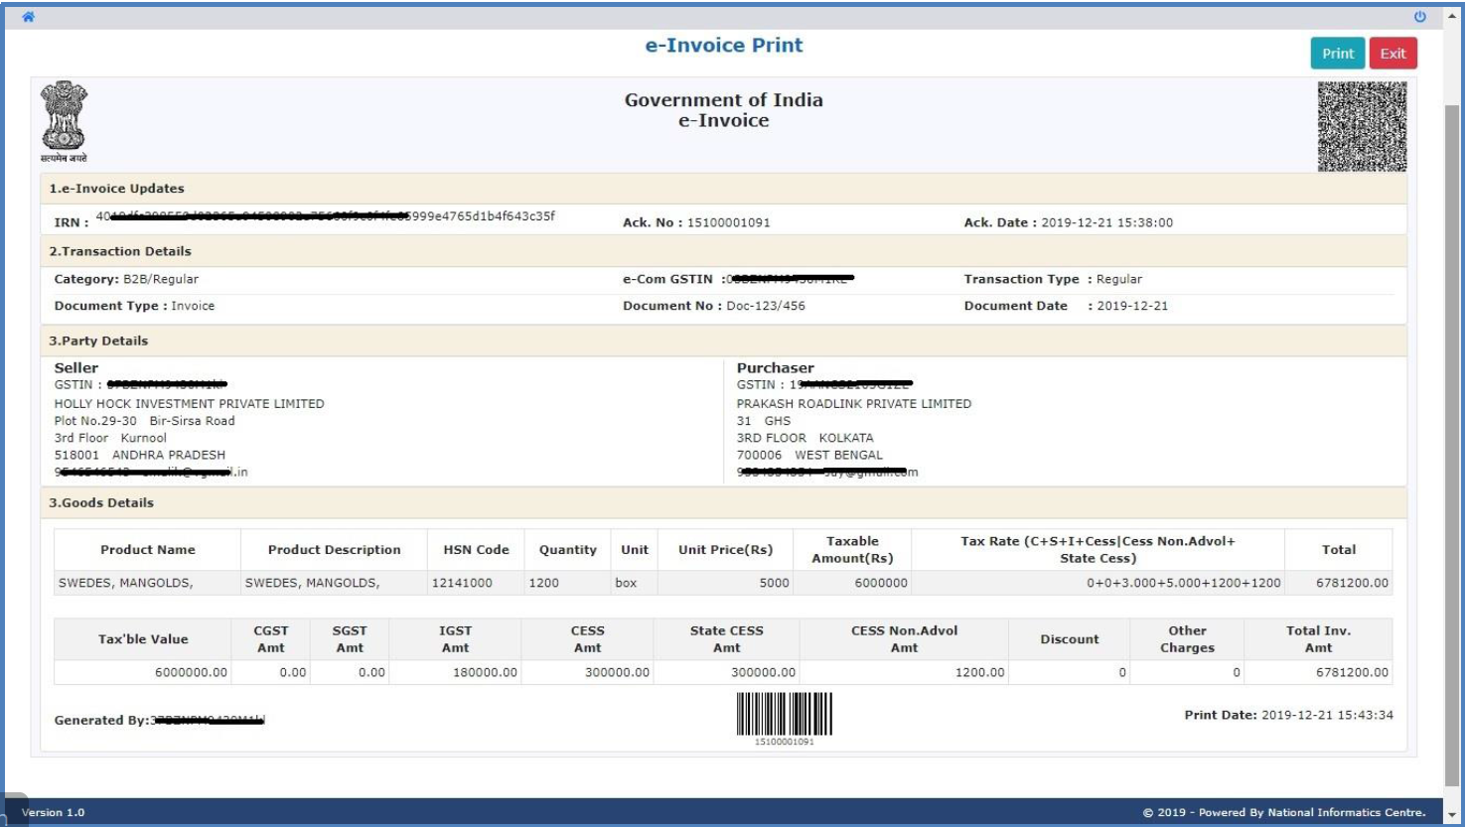
Final Generated E-Invoice

Slide 23
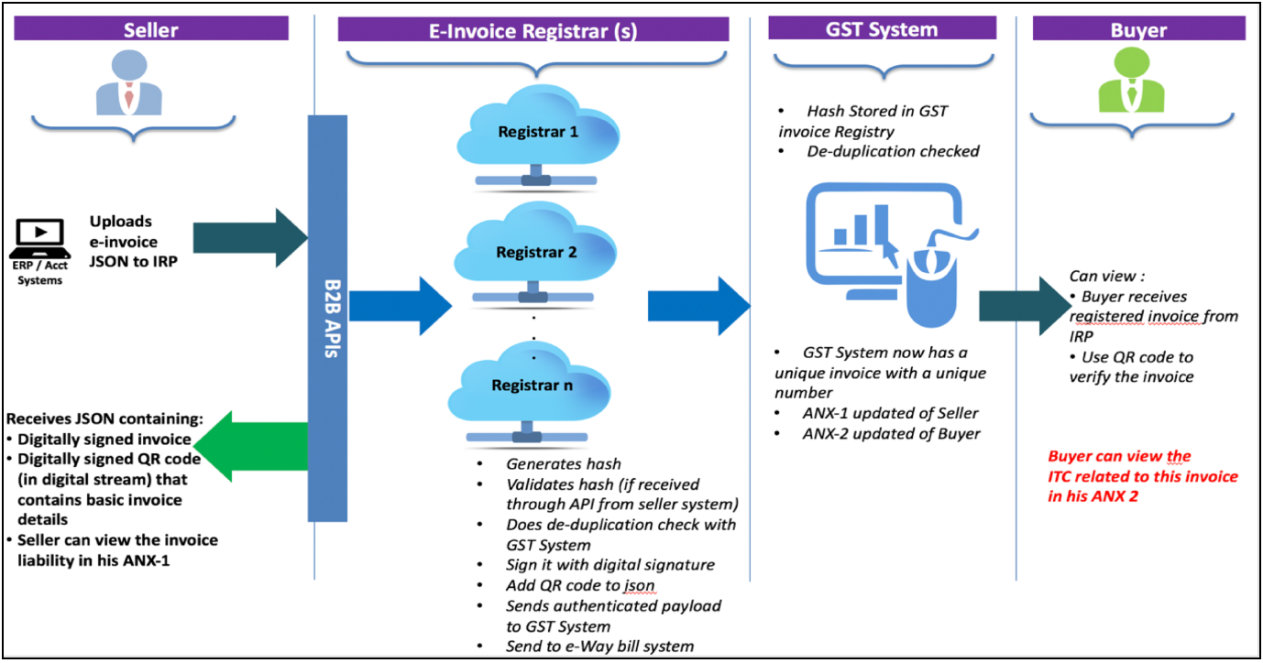
Workflow of E-invoice

Slide 24
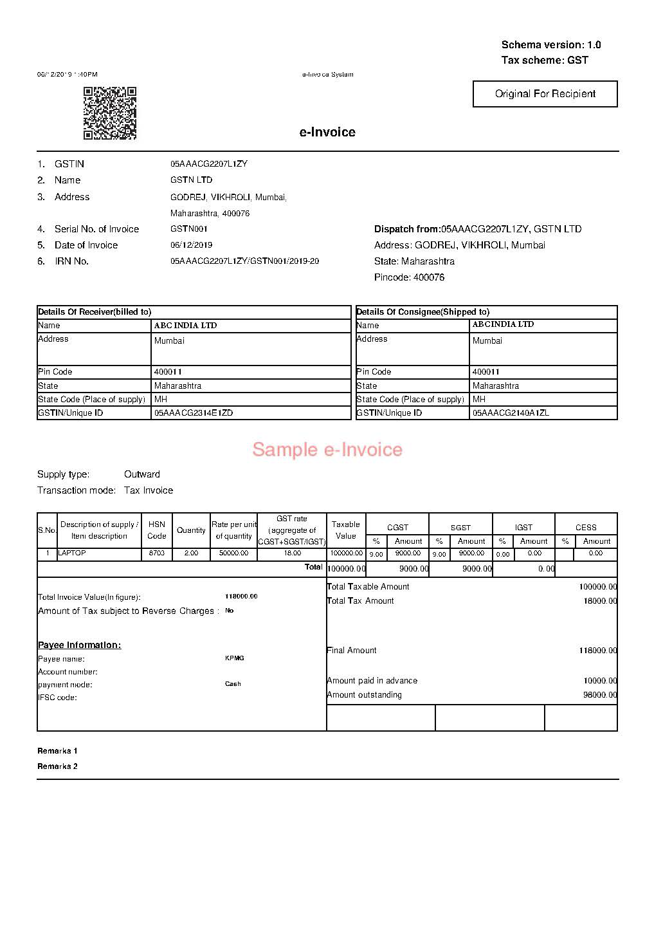

Slide 25
Trail Website
https://einvoice1-trial.nic.in/

Slide 26
THANK YOU
Team SA Chennai

